Slide 1
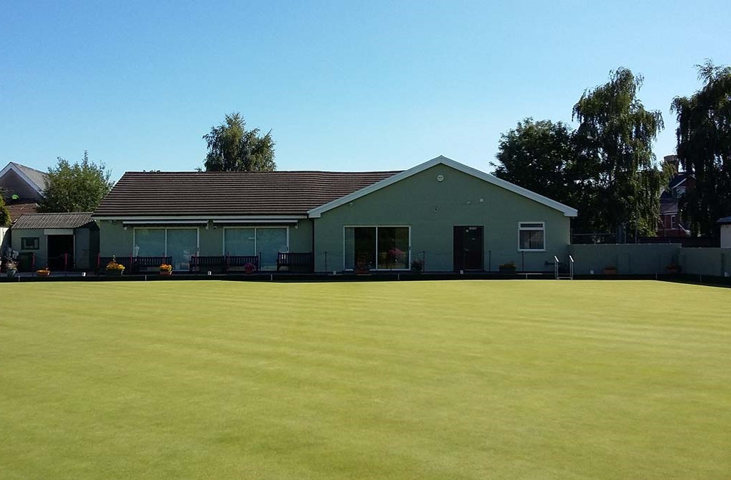

Welcome to whitchurch bowling club
2025 SEASON
Penlline Road, Whitchurch, Cardiff
02920 628044
www.whitchurchbowls.com
At the heart of our community since 1924

Slide 2
Our story
Welcome to Whitchurch Bowling Club
The club was formed in 1924 after a green was laid on land donated to the YMCA by Sir Herbert Cory, a local landowner. The green was adjacent to tennis courts, allotments, a scout troop hut and camping area in the then village of Whitchurch in Glamorgan County.
Membership soon expanded and firmly established itself within the local bowling community over the next twenty-five years.
Following the second world war, our club began to make an impact at a regional and national levels with members winning county honours and climbing up the league tables. A fire destroyed the first pavilion in 1949 and the second was replaced in our diamond jubilee year of 1984. In 1991 we purchased, from the YMCA, the land on which the clubhouse and green stand.
Currently membership stands at 123 of whom there are 79 men and 44 ladies.
In addition to a varied programme of men’s, ladies' and mixed leagues and competitions, we also offer a variety of social events in our licenced clubhouse throughout the season. You can keep up to date with all the club news via various WhatsApp groups.
We are a friendly and regionally competitive club that continues to thrive today and with 2024 being our centenary year, we continue to offer excellent facilities and a welcome to all.
Please be aware that there is limited parking at the club, and we request that you be respectful of local residents.

Slide 3
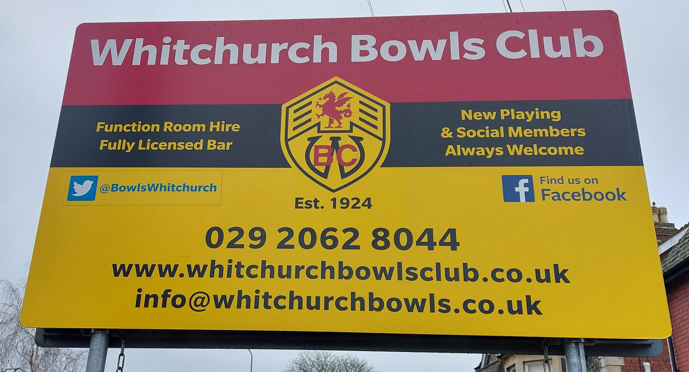
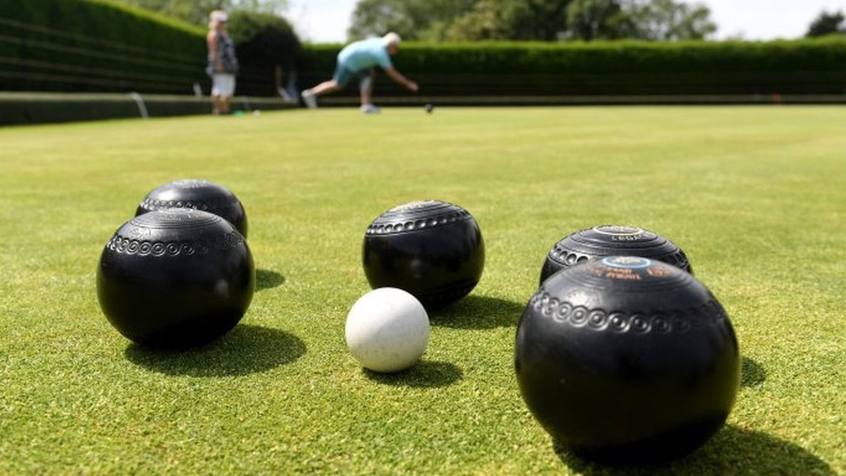
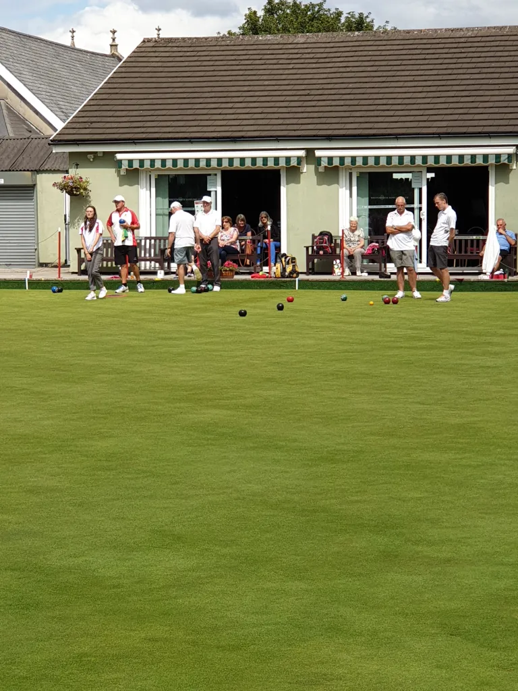
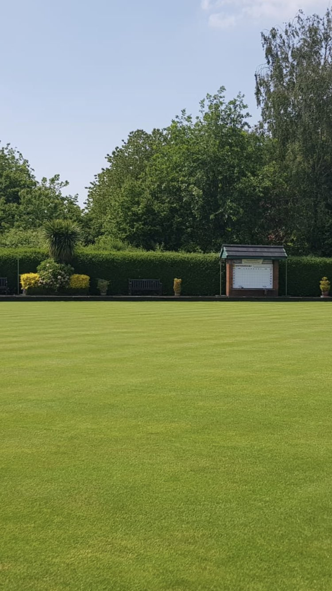
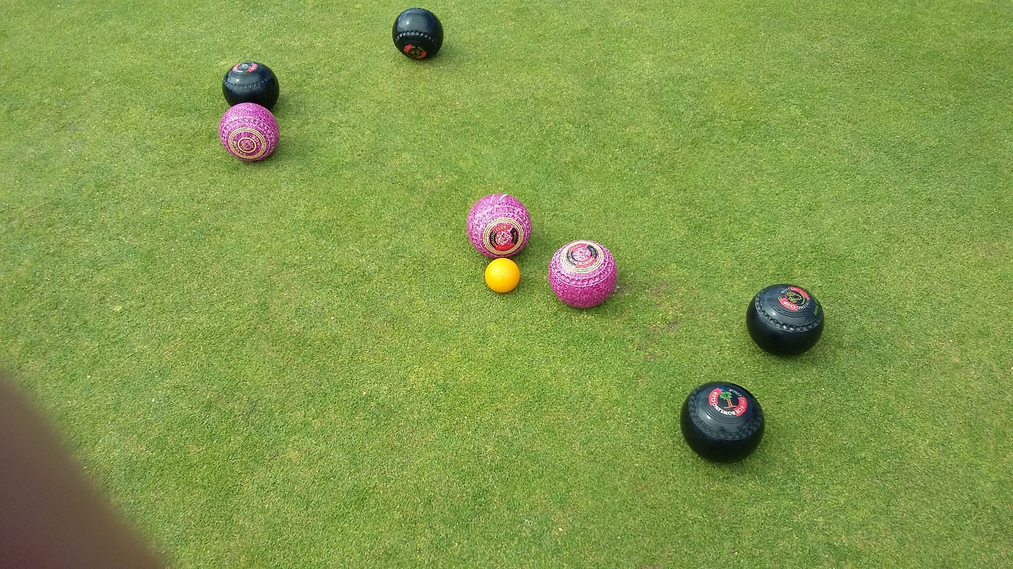
Membership
General
Full
social
etiquette
When you can play
Membership fees are paid annually, and this allows you access to the green, club house and social activities. Membership fees currently stand at £165 for Full and £82.50 for Social.
This allows you to take part in competitive league games, friendly matches, club and county competitions as well as allowing you full access to the club’s facilities.
You are free to use the club facilities, including the green for social bowling, but you do not have access to the competitive leagues or competitions.
To play on the green, you must wear flat soled shoes. A dress code will apply to all team games. The wearing of jeans is not permitted on the green at any time.
The green is normally open from 11am each day until dusk. Club league games and competitions take precedent over social bowling. Coaching is available on Fridays, 4.30 till 5.30, and club bowls are available for you to use if required.
Access to the club and clubhouse requires a key which can be obtained from our Club Secretary for a small fee. There are both men’s and ladies’ changing rooms and toilet facilities. The changing rooms have a limited number of lockers and keys can be obtained from our Treasurer.

Slide 4
Men’s teams
Subject to selection by the team captain and selection committee, you may have the option to play in one or more of the following teams:
Club Team – a competitive team which usually plays on a Saturday afternoon in the EWPGA* league. Dress code is club shirt and white trousers or shorts. It is expected that you also wear the club’s formal shirt pre and post any match.
A Team – a competitive team which usually plays on a Saturday afternoon in the EWPGA* league. Dress code is club shirt and white trousers or shorts. It is expected that you also wear the club’s formal shirt pre and post any match.
Wednesday Team – a competitive team which plays on a Wednesday evening on a league basis with progression through to a semi-final and final cup competition. Dress code is club shirt and black or grey trousers or shorts.
Alliance Team – a team game which usually plays on a Tuesday afternoon – games are played against other local teams on a friendly basis, and this is an ideal team to join if you are new to bowls. Dress code is club shirt and black or grey trousers or shorts.
A small game fee is levied and collected by the relevant team captain prior to commencement of each game.
You can make yourself available for selection and confirm your selection by signing the team sheets pinned to the noticeboard outside of the men's changing rooms.
* East Wales Private Greens Association

Slide 5
Ladies’ teams
Subject to selection by the team captain and selection committee, you may have the option to play in one or more of the following teams:
Evening League – a competitive team which plays on Tuesday evenings, usually starting at 6pm. This is a two-rink league, wearing club shirts and black shorts/trousers. Rink fee and raffle to be paid on the day.
Afternoon League – a competitive team which plays on a Thursday afternoon, times may vary but usually starting at 2pm. This is a three-rink league, wearing club shirts and white trousers/shorts/skirt. Rink fee and raffle to be paid on the day.
LDR (Ladies Double Rink) - a two-rink ladies league, where players who skip in other leagues must play up front giving other players experience at the back end. Rink fee and raffle to be paid on the day.
The availability sheets are inside the ladies’ changing rooms for you to sign off each week. There are also ladies WhatsApp groups that you will be added to for up-to-date information. Please see the captain for more information.

Slide 6
Club competitions
In addition to Men’s and Ladies’ teams, we also offer the opportunity to play in a Mixed League on Friday afternoons.
Throughout the season, you can also make yourself available for several men's and ladies’ individual competitions in addition to men’s, ladies and mixed team competitions which are run throughout the entirety of the outdoor season.
There are generally no restrictions placed upon entry to any of the competitions.
You can make yourself available for selection and confirm your selection by signing the relevant competition detail sheets pinned to the competition noticeboard alongside the men's changing rooms.
Dress code and competition rules will be advised prior to commencement of any competition.
There are also opportunities for Junior and Social bowling members to participate in events throughout the season.

Slide 7
Club supporters' account
Our Club runs a lottery which is open to any member, their family and friends for participation. All profits from this lottery are used for the development of Club facilities and the purchase of major green keeping and ancillary equipment.
When you join our Club, we would ask you to consider purchasing at least one lottery number and encourage any friends or relatives to participate, though of course, there is no obligation. There is no limitation to how many numbers you can own and just like Premium Bonds, the more numbers you have, the greater chance you have of winning.
Each number costs £5 per month which is payable by standing order.
Four prizes are paid out each month. Currently, the first prize is £250, the second is £125, the third is £75 and the fourth is £60. The prize level is reviewed regularly and if the numbers in the draw continue to increase, then either the prize level will be increased, or the number of prizes will be increased.
This is a very important fundraiser for our Club. If you, friends or relatives would like to participate, please contact
Sam Marshall on 07740 252149 or John Jackson on 07981 989937 and they will talk you through the set-up process and allocate to you your numbers.

Slide 8
contacts
Position | Name | Position | Name
Chairman | John Pearce | Men's Alliance Team Captain | Evan Williams
Vice Chairman | Sam Marshall | Men’s Wednesday Team Captain | Joe Gape
Club Secretary | Tony Atherton | Coaching Team | Barrie Dobson
Treasurer | Stuart Lewis | Coaching Team | Jim Harrison
Greens and Buildings Manager | Andy Lawrence | Coaching Team | Mark Wheadon
Bar Manager | Carole Dyson | Coaching Team | Lorraine Rogers
Catering Manager | Maureen Biernacka | Coaching Team | Wendy Thackwray
Men's Captain | Malcolm Mitchell
Ladies Captain | Wendy Thackwray
Competitions Secretary | Rob Wheadon
Men's A Team Captain | Paul Caple
Contact details are contained in the Members Handbook which is made available to you upon payment of your membership fee

